Slide 1
Setup Instructions
I implemented the exercise using the Python SDK. I implemented a kill switch flag, a targeting flag based on Segment, and a multi-variant flag.
I am providing 2 python files to run, one for the user James and the other for Mary.
*** Setup Instructions for Launch Darkly ***
You will need to create 3 Feature Flags:
ApplicationAccess :
Type: Kill Switch
Variations: Allow, Disabled
Default Variation: Disabled
Off Variation: Disabled
Targeting : Individual Targets (James and Mary)
PowerUsers:
Type: Custom
Variations: Enabled, Disabled
Default Variation: Disabled
Off Variation: Disabled
Targeting : Context is in Segment PowerUsers
Favorite Color:
Type: Custom (String)
Variations: Red, Yellow, Green
Default Variation: Green
Off Variation: Red
Targeting:
You will need to create 1 Segment Called PowerUsers
Included Targets: Mary
*** Setup Instructions for Python Files ***
You will need to have python installed on your local machine.
Both files (James.py and Mary.py) will need to be modified at line 13 to replace the sdk value passed in:
ldclient.set_config(Config("sdk-be592391-b88c-4fd6-874d-09e5b7a5e6c6")) -> ldclient.set_config(Config("YOUR SDK KEY HERE"))
The first time you run Mary.py and James.py, a context for each will be created in LaunchDarkly.
Please validate that the context keys are the same in LaunchDarkly as they are on line 24 of Mary.py and James.py
Once the contexts and the feature flags have been created, Set the values as follows:
Mary - ApplicationAccess(Enabled), PowerUsers(Enabled), FavoriteColor(Yellow)
James - ApplicationAccess(Enabled), PowerUsers(Disabled), FavoriteColor(Red)
Run the Python scripts for Mary and James. Notice the value of the feature flags
In LaunchDarkly, disable ApplicationAccess for James and run his python script
In LaunchDarkly, Change FavoriteColor for Mary to Red and run her python script

Slide 2
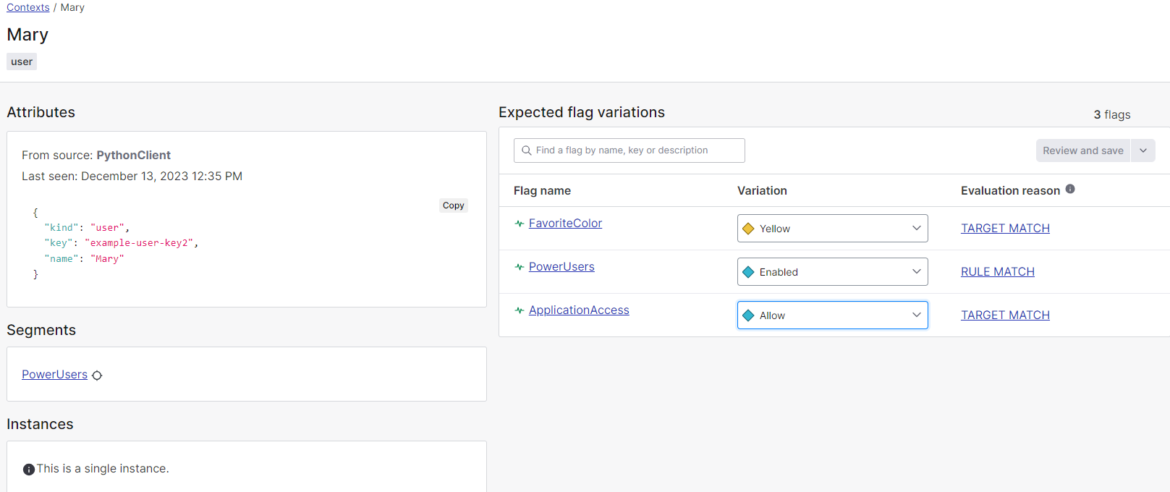
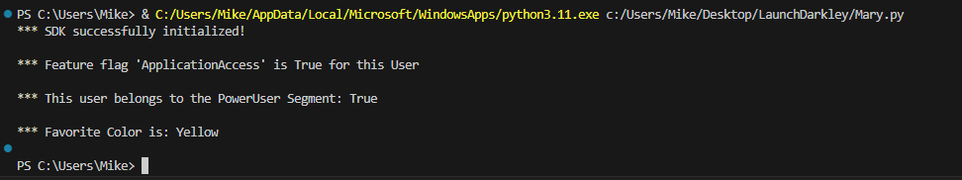
Initial State For Mary

Slide 3
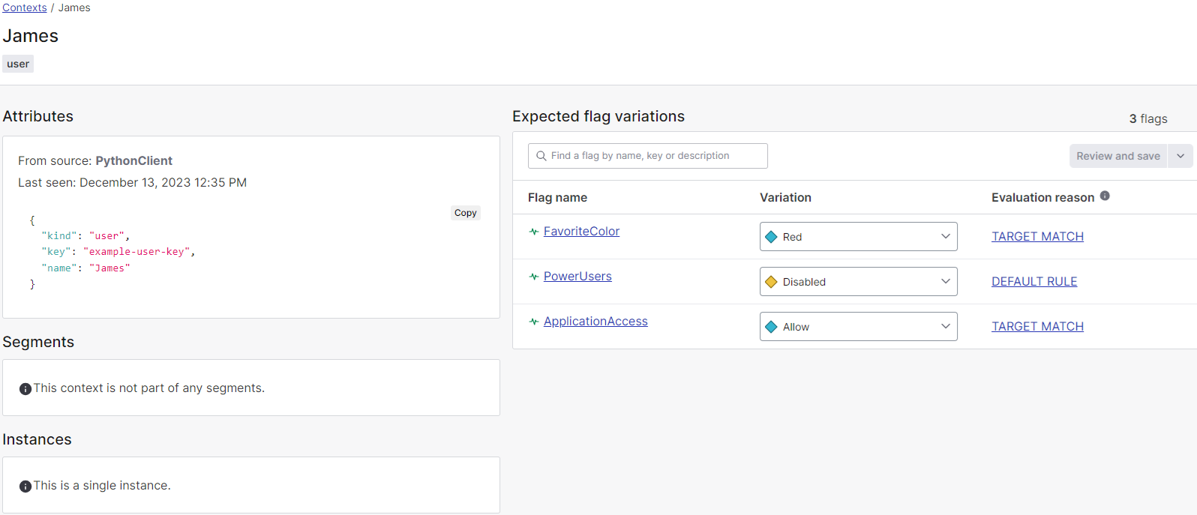
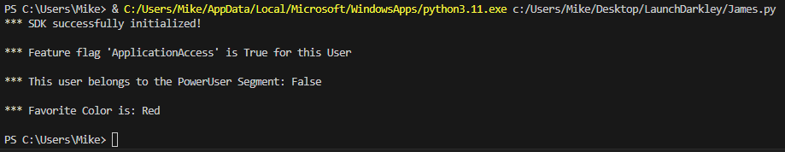
Initial State For James

Slide 4
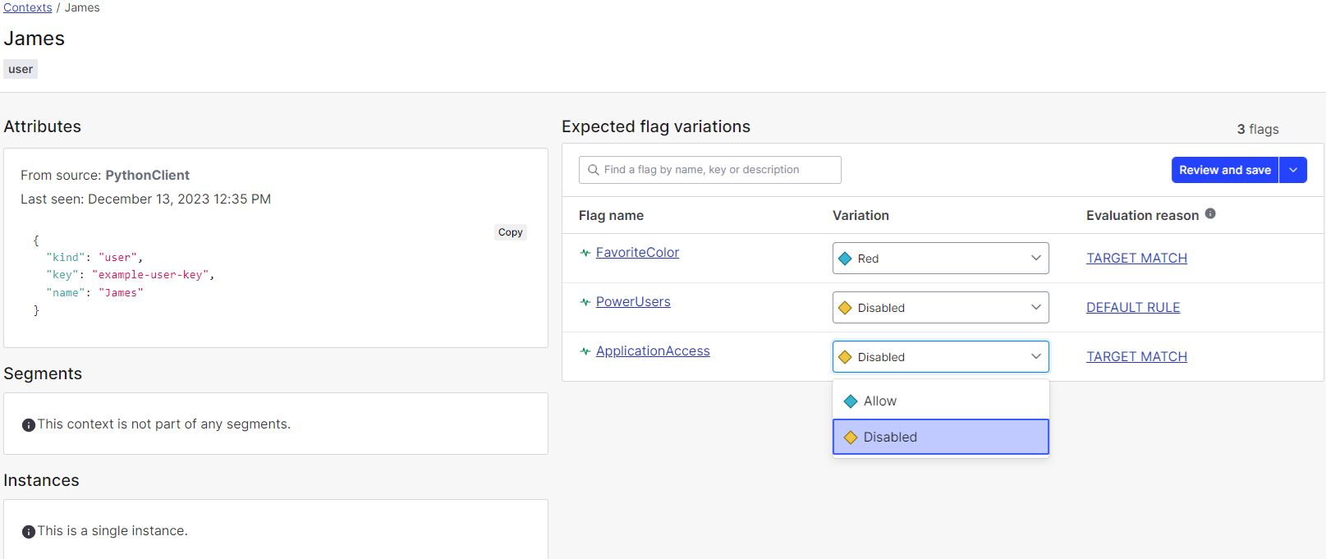
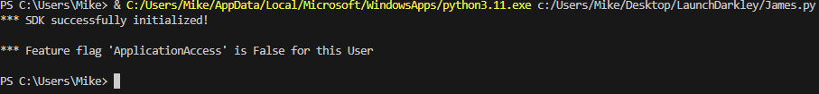
Disable Access For James

Slide 5
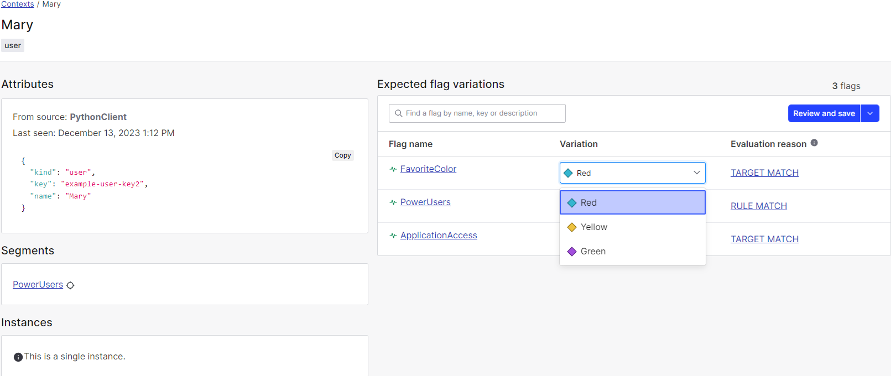
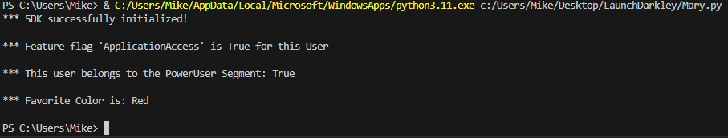
Change Favorite Color For Mary

